Slide 1
IE Annual Unit Plans
Office of Institutional Effectiveness
Rev Sept 2022

Slide 2
What is the Annual Unit Plan?
The Annual Unit Plan is the institutional assessment of all executive, administrative, student support services, and educational programs. The “Unit” is a general reference to describe a institutional department, office or program. For example, the Business Office Management program is part of the Business & Industrial Technology Department, which is one of 3 departments in the Technical Division. All 3 individual components submit “unit plans.”

Slide 3
What is the role of the IE Annual Unit Plans?
Institutional Strategic Plan
Annual Unit Plan
Program & Course Learning Outcomes
Each institution is required to have a means of assessment at the Unit level. Each Unit Plan contains several goals that link both the mission of the Unit to the goals of the institutional Strategic Plan.
(SACSCOC Standards 7.3 and 8.2.c.)
Each institution is required to have a comprehensive plan that establishes the long term mission and role of the campus. The Strategic Plan includes the Campus Mission and Vision ,with fully developed measurable strategies designed to achieve the supporting goals, values and objectives.
(SACSCOC standards 4.2.a, 7.1 & 7.3 , and state requirements for TSUS & THECB)
Each educational program is required to have a means of assessing the student learning outcomes of each institutional academic programs.
In Texas, SACSCOC provides the standards and expectations, while the Texas Higher Education Coordination Board Course and Program Student Learning Outcomes.
(SACSCOC Standards 8.2.a, 8.2.b)

Slide 4
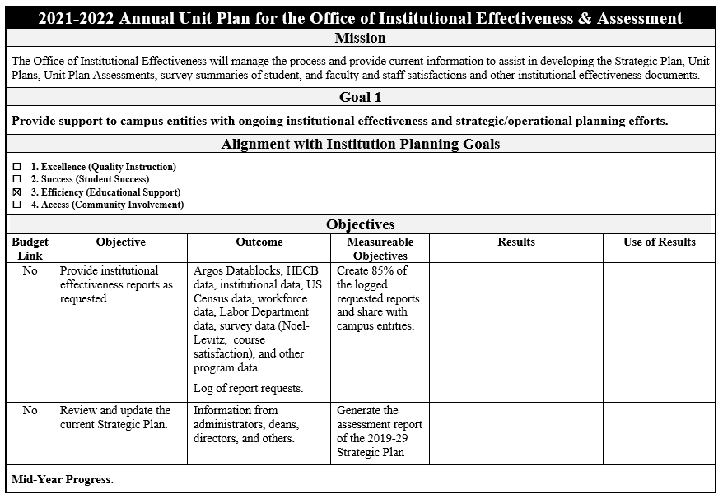

Slide 5
Components of the Unit Plan Template
Mission
Goals
Alignment to Strategic Plan
The mission statement is the stated purpose of each specific unit, as it is relates to the institutional mission statement.
Annual Unit Plan Goals are the specific achievement targets, which are linked to the institutional mission goals.
Each Annual Unit Plan should have at least 3 goals that may be unique to the unit, or may be aligned to the goals of a similar unit
Goals are generally stated in broad terms, with supporting objectives written to provide the supporting details
The goals of each IE Annual Unit Plan are aligned with the goals of the institutional Strategic Plan, (Access, Success, Excellence and Efficiency).
This alignment demonstrates that the process of institutional effectiveness is implemented across campus programs in a means that can be accessed.

Slide 6
More Components of the Unit Plan Template
Objectives
Outcomes
Measurable Objectives
Objectives are specific statements of intent or purpose that a unit expects to achieve. Objectives are measurable and aligned with a unit’s goals.
Both Performance and Learning objectives may be used by a unit, as appropriate.
Each Annual Unit Plan has a detailed and specific Outcome for each objective.
Each Outcome describes the expected achievement target of each related objective
The measurable objectives state the specific numeric or percentage benchmarks to be achieved by the related Objective. If there are federal, state or department standards, the standard(s) should be referenced.
Measurable Objectives may be fixed or adjusted from year to year.
Avoid non-measurable terms such as “all, some, most, or several.”

Slide 7
Linking the Mid Year Progress Check to Results
Mid Year Progress
Results
Use of Results
A brief statement describing the progress of each goal at the mid-year point. The purpose of the mid-year progress check is to identify any unexpected challenges, and/or accomplishments.
The Mid-Year Progress check is a reference point when doing the end of year evaluations , to write the Results narrative.
The Results are specific statements that describe the actual accomplishments in numeric or percentage terms.
Avoid singular numeric or percentage responses. Avoid terms such as “yes, no, sometimes, somewhat,incomplete, on-going. significant progress.”
Use-of Results is the narrative action plan that the office-department will strive to accomplish in the next academic year.
Avoid using terms such as “ will proceed as usual, continue with same efforts, no changes needed.”

Slide 8
Difference between Results and Use of Results
Results and Use of Results
Results
Use of Results
Results are written in past tense language. You are reporting what has already happened, in measurable terms
Use of Results are written in future tense language. You are making action plans for the next year, reflecting the related objective.
The Results are specific statements that describe the actual accomplishments in numeric or percentage terms.
The numeric/percentage results can be supported by using terms like “accomplished the objective”, or “did not accomplish the objective.”
Avoid singular numeric or percentage responses ,and cliché terms such as “incomplete, on-going. significant progress.”
Use of Results response is not a detailed explanation of the results.
The Use-of Results narratives are the action plans that the UNIT will strive to accomplish in the next academic year. Simply state what you can do to demonstrate continuous improvement
Avoid terms such as “ will proceed as usual, continue with same efforts, no changes needed.”

Slide 9
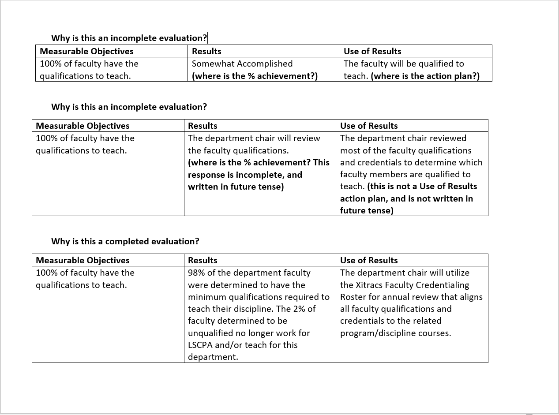

Slide 10
Evaluation: Unit Plan to Assessment Report
IE Unit Plan
Mid-Year Progress
Annual Assessment Report
The IE Unit Plan is the campus level assessment tool for all Administrative, Educational and Student Support units. This mid-level assessment tool is the link between the campus mission, vision and goals of the strategic plan to the educational program assessment of each academic department.
A brief written summary of the progress at the mid-point of the academic year. The Mid-Year Progress check is a reference point when doing the end of year evaluations , and writing the Results narrative.
Once all of the Results and Use of Results are completed, the Annual Unit Plan is finished and is renamed the IE Annual Assessment Report.
The Annual Assessment Report should be reviewed when developing the IE Annual Unit Plan for the next academic year. Some objectives are rolled forward each year, and others may be finalized and replaced with new objectives.

Slide 11
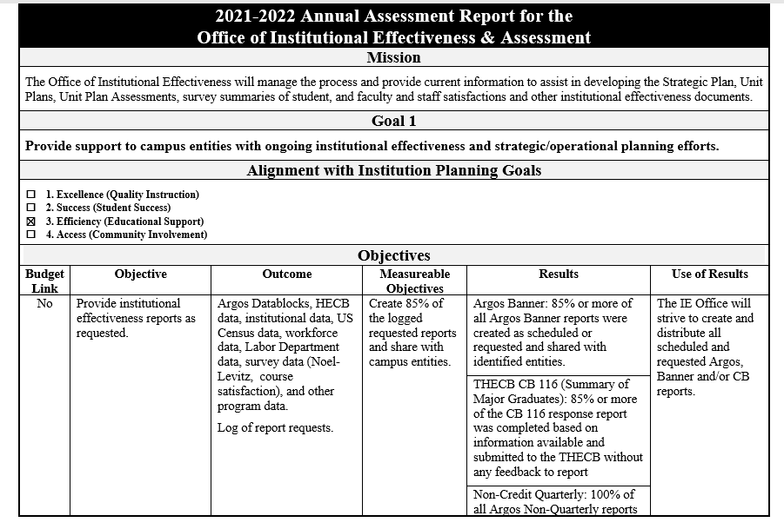
Evaluation: Unit Plan to Assessment Report

Slide 12
Contact Information
For assistance or questions with the IE Annual Unit Plan, contact the Office of Institutional Effectiveness in MMED 211: Mark Knowles,984-6432, knowlejm@lamarpa.edu

