Slide 1
Syllabus Guidelines
A LSCPA Guideline To understand State requirements
and Accreditor Compliance
Office of Institutional Effectiveness (Rev August 2022)

Slide 2
Syllabus Vocabulary
Southern Association of Colleges and Schools Commission on Colleges (SACSCOC): LSCPA’s accreditor, SACSCOC is one of six regional accreditation agencies recognized by the U.S. Dept of Education and Council for Higher Education Accreditation.
Texas Higher Education Coordinating Board (THECB): State agency that oversees all public post-secondary education in Texas
Texas Core Curriculum (TCC): Every public institution in Texas has a Core [42 semester credit hours (SCH)], which is designed to provide a solid foundation for your college education and to make transfers between and among Texas institutions of higher education as smooth and seamless as possible.
Core Curriculum Objectives: The six outcomes associated with the Texas Core Curriculum, required by THECB to be integrated into all core curriculum courses.
Program Student Learning Outcomes (PSLO): The specific skills and competencies identified for each component area (Core/Gen Ed) or workforce program (WECM). LSCPA uses the 6 Core Objectives as the institutional PSLOs, while workforce programs develop institutional PSLOs that are program specific.
Course Learning Outcomes: Course learning outcomes describe what students should be able to demonstrate in terms of knowledge, skills, and attitudes upon completion of a course.
Academic Course Guide Manual (ACGM): Official list of all lower division (freshman, sophomore) level courses approved by THECB for institutional core curriculum requirements and general academic transfer to state universities.
Workforce Education Course Manual (WECM): digital archive of all courses approved by THECB for institutional workforce(technical) programs.
Guidelines for Instructional Programs in Workforce Education (GIPWE): manual provides guidelines for the design, development, operation, and evaluation of credit and non-credit workforce education programs

Slide 3
State Regulations: During the 2009 legislative session, the Texas Legislature passed legislation, designated HB 2504; that mandates that public institutions of higher learning in the State of Texas make available to the public certain information concerning undergraduate classroom courses offered for credit. These statutory provisions are now included in Section 51.974 of the Texas Education Code.
Texas Education Code Sec 51.974
Each institution of higher education, other than a medical and dental unit, shall make available to the public on the institution’s Internet website the following information for each undergraduate classroom course offered for credit by the institution:
(1) a syllabus that:
(A) satisfies any standards adopted by the institution*
*not limited to grading policies, Course Learning Objectives, Program Student Learning Outcomes, student complaint process, student rights & responsibilities, Covid-19 Information
(B) provides a brief description of each major course requirement, including each major assignment and examination;
(C) lists any required or recommended reading; and
(D) provides a general description of the subject matter of each lecture or discussion;

Slide 4
(2) a curriculum vitae (CV) of each regular instructor:
which summarizes their career and qualifications, including at a minimum all institutions of higher education attended with degree(s) earned,
all previous teaching/staff positions including the names of the institutions, the position(s) beginning and ending dates,
a list of memberships in professional organizations,
a list of professional development activities, and
a list of significant professional publications relevant to the academic positions held including full citation data for each entry.
However, the curriculum vitae should not include any personal information, including the instructor’s email address, cell phone number, home address, or home phone number.
The standardized institutional cv template is available on the LSCPA website, under Human Resources>Faculty Resources>Curriculum Vitae.

Slide 5
LSCPA Faculty Handbook
Syllabi: Faculty are required to prepare a syllabus for each course or lab. House Bill 2504 requires the posting of syllabi that contain minimally the following information:
Course and instructor identifying information
Learning objectives
Major assignments
Required and recommended reading
Brief list/description of discussion topics
Faculty are required to submit syllabi for each lecture and lab course taught by the first day of class each semester.
The Office of Institutional Effectiveness has created this Syllabus Guidelines to assist faculty through the process of filling out the Syllabus Template. Syllabi from the current and previous semesters are available to the public by going to the Course and Faculty Information (HB 2504) webpage.

Slide 6
SACSCOC Requirements: As described in the Principles of Accreditation, SACSCOC requires evidence that the institution make available to the public certain information concerning undergraduate classroom courses offered for credit. This includes any course pre-requisites, learning outcomes (course and program), calendars with content and assignments, grading scales, student complaint procedures, student rights & responsibilities. The following standards are a few of the standards that are dependent on current and current syllabi
Standard 8.2.a- The institution identifies expected outcomes, assesses the extent to which it achieves these outcomes, and provides evidence of seeking improvement based on analysis of the results in the Student learning outcomes for each of its educational programs,
Standard 8.2.b- The institution identifies expected outcomes, assesses the extent to which it achieves these outcomes, and provides evidence of seeking improvement based on analysis of the results in the student learning outcomes for collegiate-level general education competencies of its undergraduate degree programs
Standard 9.1- Educational programs (a.) embody a coherent course of study, (b.) are compatible with the stated mission and goals of the institution, and (c.) are based upon fields of study appropriate to higher education.
Standard 10.1- The institution publishes, implements, and disseminates academic policies that adhere to principles of good educational practice and that accurately represent the programs and services of the institution.
Standard 10.2- The institution makes available to students and the public current academic calendars, grading policies, cost of attendance, and refund policies
Standard 12.3- The institution publishes clear and appropriate statement(s) of student rights and responsibilities…
Standard 12.4- The institution (a.) publishes appropriate and clear procedures for addressing written student complaints…

Slide 7
Course Outcomes, Core Objectives and Program Outcomes
COURSE LEARNING OUTCOMES: Courses in all educational programs have course student learning outcomes(CSLOs). Academic course outcomes are described in the Academic Course Guide Manual (ACGM). Technical /Workforce course outcomes are described in the Workforce Education Course Manual (WECM). Links are found on the syllabus template.
CORE OBJECTIVES: The (Texas) Core Objectives are the six outcomes (PSLOs) associated with the Texas Core Curriculum (TCC), required by THECB to be integrated into all core curriculum & general education courses. These include critical thinking, communications, empirical and quantitative reasoning, teamwork, social responsibility and personal responsibility
Program Student Learning Outcomes (PSLOs) are general education or workforce specific. The PSLOs for general education courses are arranged by the related foundation component area. The PSLOs for each workforce program are institutionally developed, program-specific, and available on the LSCPA IE Campus Resource webpage.
Foundation Component Areas : the organizational grouping for each core curriculum: Communication (6 SCH) Mathematics (3 SCH) Life and Physical Sciences (6 SCH) Language, Philosophy and Culture (3 SCH) Creative Arts (3 SCH) American History (6 SCH) Government/Political Science (6 SCH) Social and Behavioral Sciences (3 SCH) and Component Area Option (6 SCH)
SACSCOC requires that institutions provide evidence that the learning outcomes are communicated to all students in all locations (traditional campus, correctional education, dual enrollment, Early College High School [ECHS]) by all delivery modes (in person, online, hybrid).

Slide 8
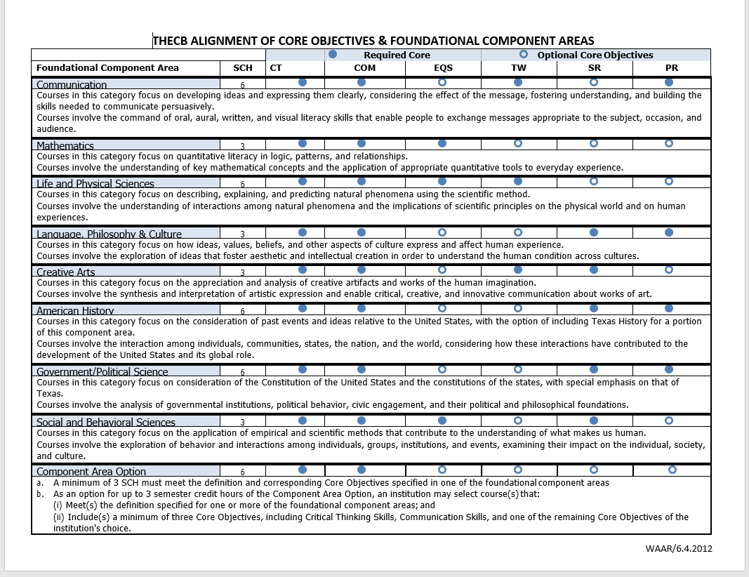

Slide 9
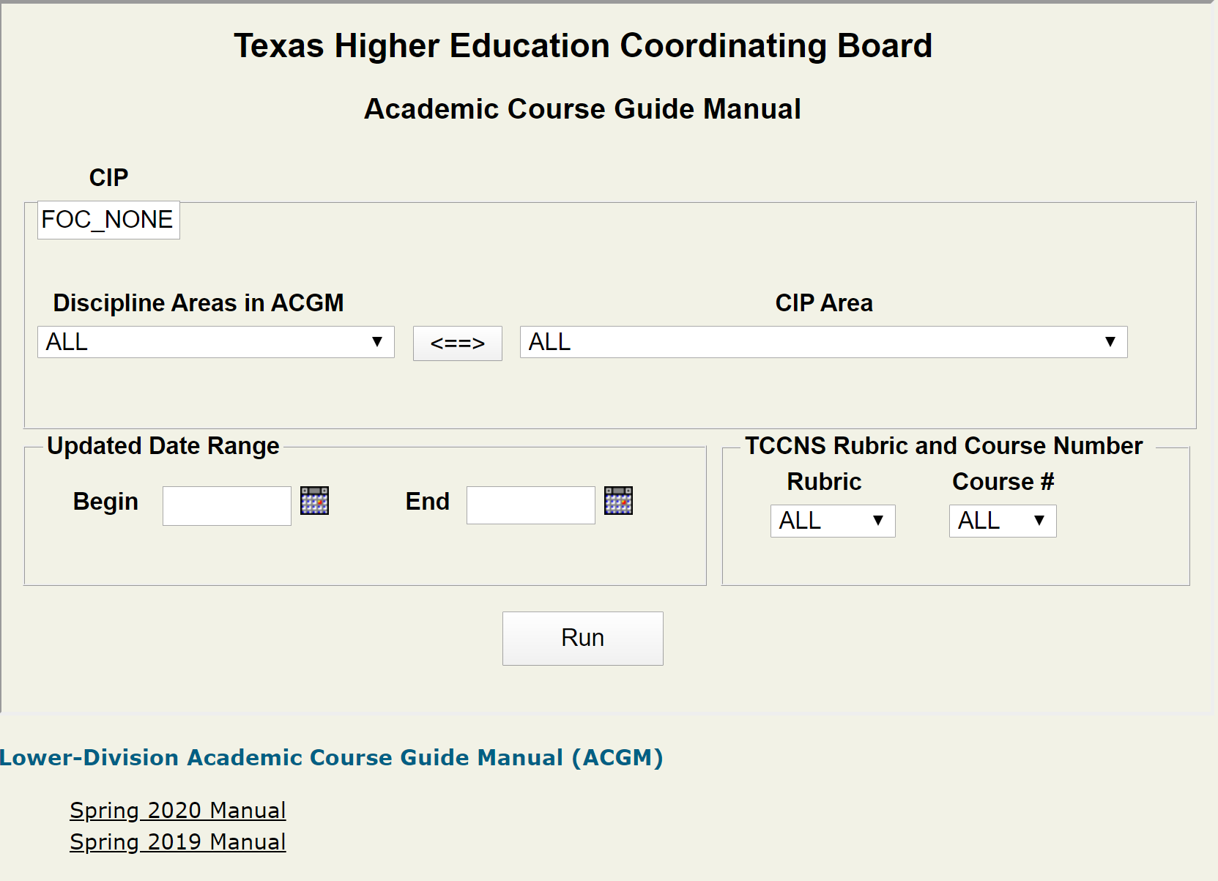

Slide 10
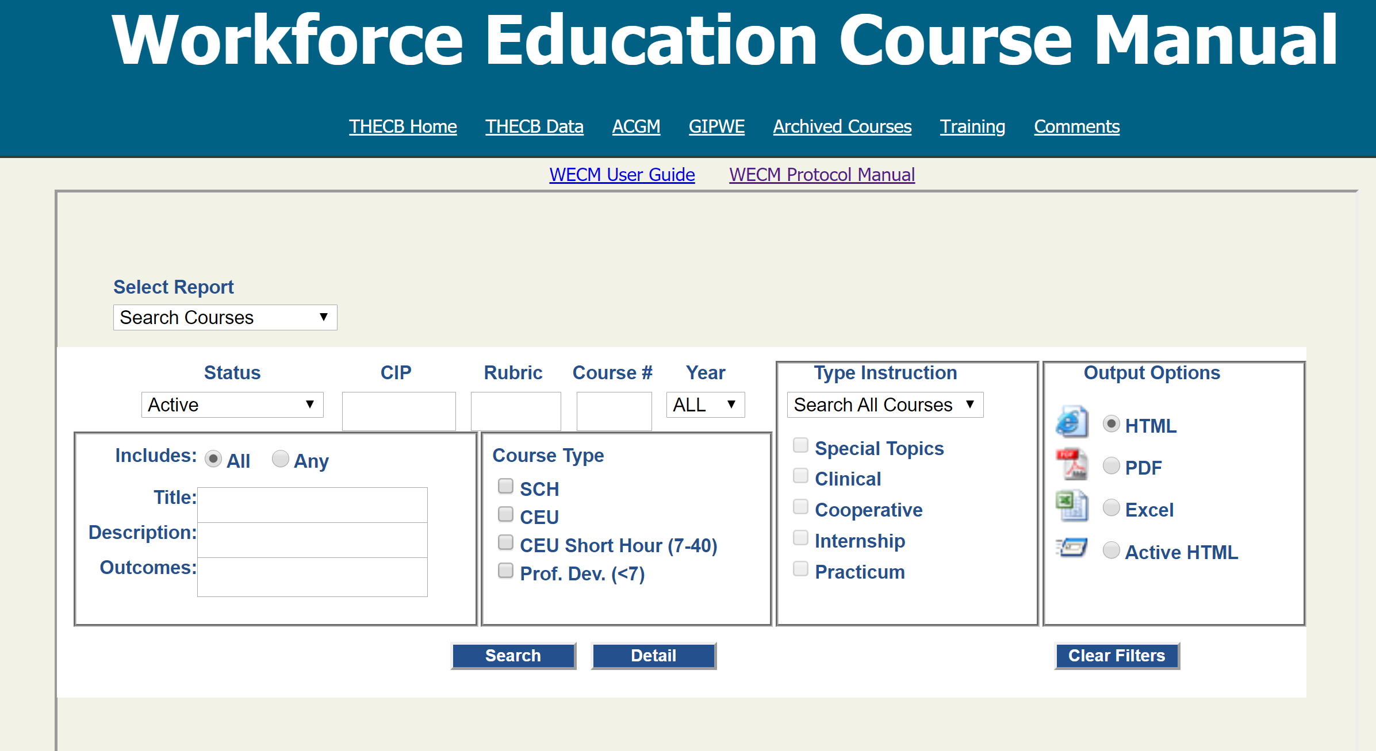

Slide 11
Calendars and Grading Scales
SACSCOCs requires that institutions provide evidence that the curriculum and instruction is consistent regardless of mode or location. Standard 10.2 “The institution makes available to students and the public current academic calendars, grading policies, cost of attendance, and refund policies.”
The Lecture Topics Outline demonstrates that faculty do communicate the same content to all students in all locations in all modes, regardless of the semester length. This is demonstrated by showing the week-to-week planning for each semester.
The Major Assignment Schedule demonstrates that the same assessments are accomplished regardless of the semester length. This is demonstrated by identifying only the major assignments, and not the full lecture outline.
The Grading Scale and Determination of Final Grades demonstrate consistency in all modes and locations.

Slide 12
Lecture Topics Outline and Major Assignments Schedule
Lecture Topics Outline is a week by week list of course content.
Brief listing such as the chapter heading
Introduction
Chapter 1 interactive discussions of specific course content
Chapter 2 interactive discussions of specific course content
Chapter 99 discussions
Major Assignments Schedule is a week by week listing of scheduled assignments
Dates ( week or exact days) of scheduled assignments, not lecture content
Such as Week/Day: Quiz 1, Content/Chapter(s)
Week/Day: Essay 1, Content
Week/Day: Test 1, Content/Chapter(s)
Month/Day: Mid-term Exam Content/Chapter(s)
Last week of semester: Final Exam

Slide 13
Final Exam Date
Drop down menu requires selection of day and time for each course
Grading Scale
A/S= use point range, B= use point range, C= use point range, D= use point range, U/F= use point range
Determination of Final Grade
Assignments by percent or points.
Such As: Discussions/Chat Room engagement by percent or points
Projects/Presentation by percent or points
Quizzes by percent or points
Tests by percent or points
Final Exam by percent or points
Attendance by percent or points

Slide 14
Standard Syllabus Content
Course Policies
Institutional Policies
Instructor Policies: Any instructor comments regarding their course expectations for students
Attendance Policy: Instructor comments on physical/virtual attendance, assignment due dates, and/or student responsibilities
Additional Information : Instructor comments on anything previously not addressed,(i.e. email/voice mail etiquette, calendar changes, technical/internet issues, etc.)
MyLSCPA Academic Honesty
ADA Consideration Covid-19 Information
Facility Policies HB 2504
Federal Requirements
Grievance/Complaint/ Concern
Department Information

Slide 15
As stated, all syllabi are subject to review by THECB or SACSCOC when submitted as evidence of compliance in related assessment reports.
State Requirements: THECB requires each institution submit an assessment of the Institutional Core Curriculum every 10 years. Syllabi are collected from every core curriculum course for the full year prior to the report submission date.
SACSCOC Requirements: SACSCOCs requires each institution submit compliance certifications every 5th year (Fifth-Year Interim Report:24 standards), and every 10th year (Reaffirmation:72 standards). Your syllabi are collected from every degree program and/or course for the full year prior to the report submission date.

