Slide 1
Educational Program Assessment
LSCPA Office of Institutional Effectiveness
& Assessment
updated Jan 2023

Slide 2
Educational Program Assessment
Useful Vocabulary and Key points of this presentation:
Overview of Institutional Effectiveness
Assessment Definitions and Purpose
General Education (content, purpose)
Technical (content, purpose)
Foundation Component Areas, Core Objectives and Alignment
Basic Steps of LSCPA Academic Assessment
Planning, Fall & Spring Assessment/Submission, Results, Use of Results
Academic Assessment FAQ

Slide 3
Useful Vocabulary
Assessment: the expansive process of analyzing the degree to which all educational courses (general education and technical/workforce), are accomplishing the measures of achievement established in all program student learning outcomes (PSLOs)
Educational Programs: As per the 2020 interpretation letter for SACSCOC Standard 8.2.a, Educational Programs are the institution’s different programs provided under the Associate of Arts, Associate of Arts in Teaching and Associate of Applied Science/Certificate degrees. (transcripts, LSCPA website, LSCPA catalog)
THECB: Texas Higher Education Coordinating Board, the authority of higher education in Texas
ACGM: (Academic Course Guide Manual) list of all approved undergraduate academic courses (includes descriptions, course learning outcomes, and more)
WECM: (Workforce Education Course Manual) portal for all approved technical courses (includes descriptions, course learning outcomes, and more)

Slide 4
Overview of Institutional Effectiveness
At LSCPA, Institutional Effectiveness focuses on student achievement and methods to accomplish continuous institutional improvement.
The Strategic Plan: Provides institutional guidance with the expansive Mission and Vision statements, basic goals (Access, Success, Excellence and Efficiency) and far-reaching objectives. SACSCOC Standard 7.1
The IE Annual Unit Plans: One implementation of the Strategic Plan that measures the degree to which administrative, education and student support offices and departments strive to seek continuous improvement in providing student support and services. SACSCOC Standards 7.3, 8.2.c
Educational Program Assessment: As per SACSCOC Standard 8.2.a, “the institution identifies expected outcomes, assesses the extent to which it achieves these outcomes, and provides evidence of seeking improvement based on analysis of the results in the Student Learning Outcomes for each of its educational programs.” At LSCPA, this addresses programs identified under the Associate of Arts, Associate of Arts in Teaching, and Associate of Applied Science/Certificate programs

Slide 5
SACSCOC Overview of Assessment
Educational Program assessment is addressed in SACSCOC Standard 8.2.a :
“the institution identifies expected outcomes,
assesses the extent to which it achieves these outcomes, and
provides evidence of seeking improvement based on analysis of the results in the Student Learning Outcomes for each of its educational programs.”
At LSCPA, these are the programs identified under the Associate of Arts, Associate of Arts in Teaching, and Associate of Applied Science/Certificate programs
General Education assessment is addressed in SACSCOC Standard 8.2.b:
“the institution identifies expected outcomes,
assesses the extent to which it achieves these outcomes, and
provides evidence of seeking improvement based on analysis of the results in Student learning outcomes for collegiate-level general education competencies of its undergraduate degree programs. “
At LSCPA, the general education competencies are identified under the Associate of Arts in Academic Studies, which is the annual assessment of the LSCPA Core Curriculum. This assessment report is currently submitted as the THECB Core Curriculum Report as a separate submission of the SACSCOC reaffirmation report(s).

Slide 6
Educational Program Assessment
Purpose of Assessment?
As Linda Suskie writes in Assessing Student Learning, “there are at least three purposes of assessment: “The fundamental purpose is giving students the best possible education. Assessment accomplishes this by giving faculty and staff feedback on what is and isn’t working and insight into changes that might help students learn and succeed even more effectively.
“The second purpose of assessment is stewardship. All colleges run on other people’s money, including tuition and fees paid by students and their families, government funds paid by taxpayers, and scholarships paid by donors. Stewardship includes using good-quality evidence of student learning to help inform decisions on how those resources are spent, including how everyone spends their time.
“The third purpose of assessment is accountability: assuring your stakeholders of the effectiveness of your college, program, service, or initiative.
AND…other requirements (THECB) & the Accreditation Principles (SACSCOC)

Slide 7
Educational Program Assessment
The Core Curriculum is the collection of academic courses that are approved by the Texas Higher Education Coordinating Board (THECB) to form LSCPA’s Core Curriculum. As per THECB, when completed, the LSCPA Core is transferable to any Texas public higher education institution.
General Education (GenEd) courses are academic courses that are not currently part of the core curriculum, but are the electives that complete the various associate of arts degrees (i.e., academic studies, business administration, criminal justice, drama, kinesiology, music, studio art, and others). These contributions involve every department on the LSCPA campus.
Technical Courses are the program-specific courses that form the Associate of Applied Sciences and Certificates (level I & II, ATC) in each Technical Department (AH, B & IT, CMVPA), designed to provide students with the knowledge and skills necessary for immediate employment in business and industry.

Slide 8
Educational Program Assessment
Program Student Learning Outcomes
Some of the Associate of Arts programs use the Core Objectives , and
Other Associate of Arts and Associate of Arts-Teaching programs have institutionally developed program specific learning outcomes
All of the Associate of Applied Science/Certificate educational programs use institutionally developed program-specific learning outcomes
Course Student Learning Outcomes (not a focus of LSCPA assessment)
Academic educational disciplines use the THECB ACGM course learning outcomes
Technical education programs use the THECB WECM course learning outcomes

Slide 9
For the Associate of Arts and the Associate of Arts-Teaching, all courses come from the Academic Course Guide Manual (ACGM):
The Academic Course Guide Manual is the THECB directory for all academic courses authorized to be taught with full state support and funding.
Courses from each foundation area are selected from the ACGM to form the Core Curriculum.
Other courses are used as General Education electives in specific program degrees
ACGM Courses
Campus Core
or
General Education

Slide 10
For the Associate of Arts and the Associate of Arts-Teaching, the Core Curriculum is the foundation on which each degree is created. However, the Core Curriculum itself is not a degree, but a progress measure that is noted on each Degree-Works transcript as being core completed or core incomplete.
The Associate of Arts for Academic Studies Assessment Report is the assessment of all core classes. It contains the assessment of every core course, every core objective in every delivery style and every type of student. Once every 10 years, in conjunction with the SACSCOC Reaffirmation report, it is submitted to the THECB as the Core Curriculum report
ACGM Courses
Campus Core

Slide 11
For the program-specific Associate of Arts and the Associate of Arts-Teaching degree plans, the Core Curriculum is the foundation on which each degree is created. Program specific courses are selected as electives to complete the degree plan.
These include the Associate of Arts and Associate of Arts-Teaching in:
AA, Business Administration
AA, Criminal Justice
AA, Drama
AA-T, Theatre Arts
AA, Kinesiology
AA-T, PE
AA, Studio Arts
AA-T, Arts
ACGM Courses
Core & General Educ

Slide 12
For the Associate of Applied Science and/or Certificates, all courses come from the Workforce Education Course Manual WICM:
The Workforce Education Course Manual is the portal for all approved technical courses (includes descriptions, course learning outcomes, and more)
Courses from each program area are selected to form the degree plan.
15 SCH of Academic courses, core or general education, are required to complete the degree plan.
WICM Courses
Degree plan
with
15 SCH General Education

Slide 13
Associate of Applied Science and Certificates
Accounting
Audiovisual Production
Business Office Management
Cosmetology (instructor/operator)
Commercial Music Performance
Commercial Music Audio Engineering
Culinary Arts and Hospitality
Drafting
Graphic Design
HVAC
Instrumentation
Medical Coding Specialist
Medical Office Administration
Paralegal
Process Technology
Software Dev/Game Design
Substance Abuse Counselor
Upward Mobility LVN to AND
Vocational Nursing
Nurse Aide
Pharmacy Tech
Welding

Slide 14
Educational Program Assessment
Educational Program Assessment at LSCPA is scheduled as an annual process, in the Fall and Spring semesters, with Summer assessment accomplished on any courses not taught and/or assessed in the longer semesters. Currently, the assessment process is accomplished using Excel workbooks and Word documents .
Four Basic Steps of LSCPA Educational Program Assessment
Planning
Fall , Spring, and Summer Assessment & Submission
Results (analysis, and reporting)
Use of Results (action plans)

Slide 15
Planning
Your Role: where do you, as the content expert for your program/discipline, fit into this activity?
Your Schedule: which course(s) will you be teaching and assessing each semester?
Your Content Area: where do your courses fit into your program degree or certificate?
Your PLSO’s: which program learning outcomes will you be responsible for assessing and reporting?

Slide 16
Educational Program Assessment
Create Assignment(s), content specific, and designed to measure specific learning outcomes
Identify Objective(s): the Program Learning Outcomes
Administer the assessment tool
Collect 10 Artifacts for each delivery style and type of student
i.e., 10 artifacts from Traditional Face to Face, 10 from Online Dual Credit…
Small classes may be merged if delivery & student type are identical
Complete the Assessment Submission Workbook
Submit via your department chair

Slide 17
Assessment Assignments
Instructors may select any assignment (homework, quiz, test, essay, project, performance, etc.) that includes content that can be measured by the learning outcome measure. It may not require 3-4 different assignments, but rather maybe 1-2 assignments can be designed that measure multiple outcomes.
Example: a written exercise or test in which a certain part is designed to measure Outcome 1 and/ or 2, a different part is designed to measure Outcome 2 and/or 3

Slide 18
Results
LSCPA Educational Program Assessment is conducted under the guidance of the Office of Institutional Effectiveness and Assessment.
Artifacts are collected each semester, and processed for reporting.
Each submission is analyzed for each separate objective: average rating of each course 0-4, and the percent of submissions rated 70% or more.
Each academic course is recorded into an excel analysis table, sorted by core objective, including every foundation component area, every type of delivery and every style of student.
Each technical course is processed into an excel analysis table, sorted by program for each department, including every type of delivery, and every style of student.
The summary analysis for each department/program is reported into a Educational Assessment Annual Report, disaggregated by type of delivery and style of student.

Slide 19
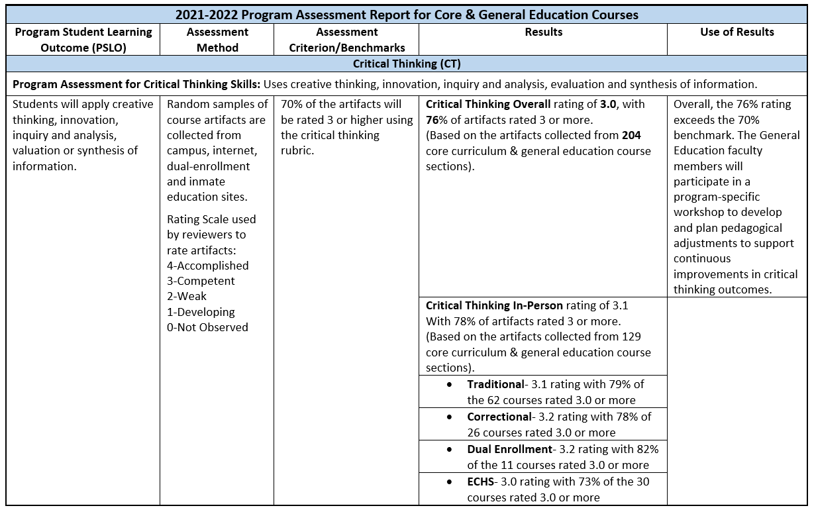
Sample of IE Assessment Report with Results for General Education: The standardized template is the 5-column model: PSLO’s, Assessment Method, Benchmarks, Results ( by PSLO, by method, by type of student), and standard Use-of-Results narrative.(completed Use of Results in next slide)

Slide 20
Use of Results
Faculty from each subject/disciple review the Associate of Arts, Associate of Arts in Teaching , or Associate of Applied Science Assessment Annual Report, and consider one question:
What are we going to do in our program to improve the results for each of our PSLO’s for our next assessment cycle?
The Use of Results action plans are developed to address these objective activities (pedological revisions) that will lead to and strive to demonstrate continuous improvement.

Slide 21
Sample of Use of Results (action plan statement that addresses the related PSLO that describes what activity/assignment will be implement in efforts to produce and demonstrate continuous improvement)
General Education: Overall, the 76% rating exceeds the Critical Thinking 70% benchmark. The General Education faculty members will participate in a program-specific workshop to develop and plan pedagogical adjustments to support continuous improvements in critical thinking outcomes.
In General Education, each discipline will submit a short but thorough narrative for each PSLO: Arts, Biology, Chemistry…Speech
The Arts faculty will develop a Critical Thinking exercise in which Art students research artists from a designated period, and discuss which social conditions may have been influential in the artist’s artwork.
Technical Programs: Overall, the 79% rating exceeds the Program benchmark of 70%. The program faculty members will participate in a program-specific workshop to develop and plan pedagogical adjustments to support continuous improvements in the program outcomes.
In Technical Courses, each program will submit a short but thorough narrative for each of the Program Outcomes ( i.e, Students will be introduced to current professional, legal and ethical guidelines within the program workplace.)
The program faculty will schedule guest lecture sessions featuring members of the program advisory committee to discuss and demonstrate current professional, legal and ethical guidelines in the program workplace.

Slide 22
FAQ’s of Educational Program Assessment
How are instructors informed of assessment responsibilities each semester? Department chairs notify each discipline instructor with the schedule of the course(s) and PSLO(s) that are to be assessed in the semester.
How are assessment assignments created that accurately measure each specific PSLO? Instructors work with other instructors in the discipline/program to create a shared common assignment, or work independently to create the assignment. The assessment assignment may focus on one or more PSLOs, or may be an embedded section of an existing assignment.
When to administer the assessment assignment? The assessment assignment can be given at any point in the semester, with some instructors using the mid-term or final exam assignment.
What are assessment artifacts? Artifact in the context of assessment refers to the final product of the assessment used to measure performance or competency in a set of skills (PSLOs): written papers, exams, performances, portfolios.
How are the assignments rated? Each discipline/program has developed a PSLO scoring rubric designed for the assessment assignment. Each rubric uses a 5-level performance model (0-4): Excellent, Good, Fair, Poor, Not Observed. Grades are not the same as artifact ratings.

Slide 23
FAQ’s of Educational Program Assessment
How are the assessment assignments submitted? The OIE has designed the Excel workbook that contains a sample, several blank templates and links to resources for related information.
What happens with the assessment artifacts? After the submission form is completed, the submission form, artifacts, scoring rubrics and original assignment are submitted to the department head.
What happens to the course assessments? The OIE collects, analyzes and creates reports for each department/program. Results are analyzed in comparison to campus benchmarks, and prior year results. Results are scored as 1 of 3 levels: benchmarks not met, met or exceeded.
What’s the follow-up action for course assessment? Based on the OIE assessment report, each department/program will create an action plan for each PSLO that addresses pedagogical changes that will be implemented into the related course, actions that seek continuous improvement in the related course. While this is referred to as “Closing the Loop,” effective assessment is actually an ongoing process that flows in a continuous spiral.

Slide 24
Resources and More Information
Office of IE : MMED 211 984-6432
THECB information, LSCPA Core Curriculum, Rating Rubrics
Office of IE Webpage > Faculty Resources (documents and portals)
ACGM (Academic Course Guide Manual) the THECB list of every approved undergraduate academic course approved for The Core. (Includes course student learning outcomes)
WECM (Workforce Education Course Manual) the THECB interactive portal for every approved technical course.
Assessment Workbooks (Excel) for Academic and Technical submissions
Various THECB Resources

