Slide 1
Quick Tips for Blackboard Academic Assessment
MyLSCPA Blackboard Card
Blackboard Institution Page
Blackboard Organizations
LSCPA Academic Assessment
LSCPA Tasks to Complete
LSCPA Submission Form and Uploads for Academic Assessment
LSCPA Submission Form for Academic Assessment
LSCPA Artifact Uploads for Academic Assessment

Slide 2
Easy Access to Blackboard: Use your MyLSCPA,and click on the Blackboard learn+ “card”

Slide 3
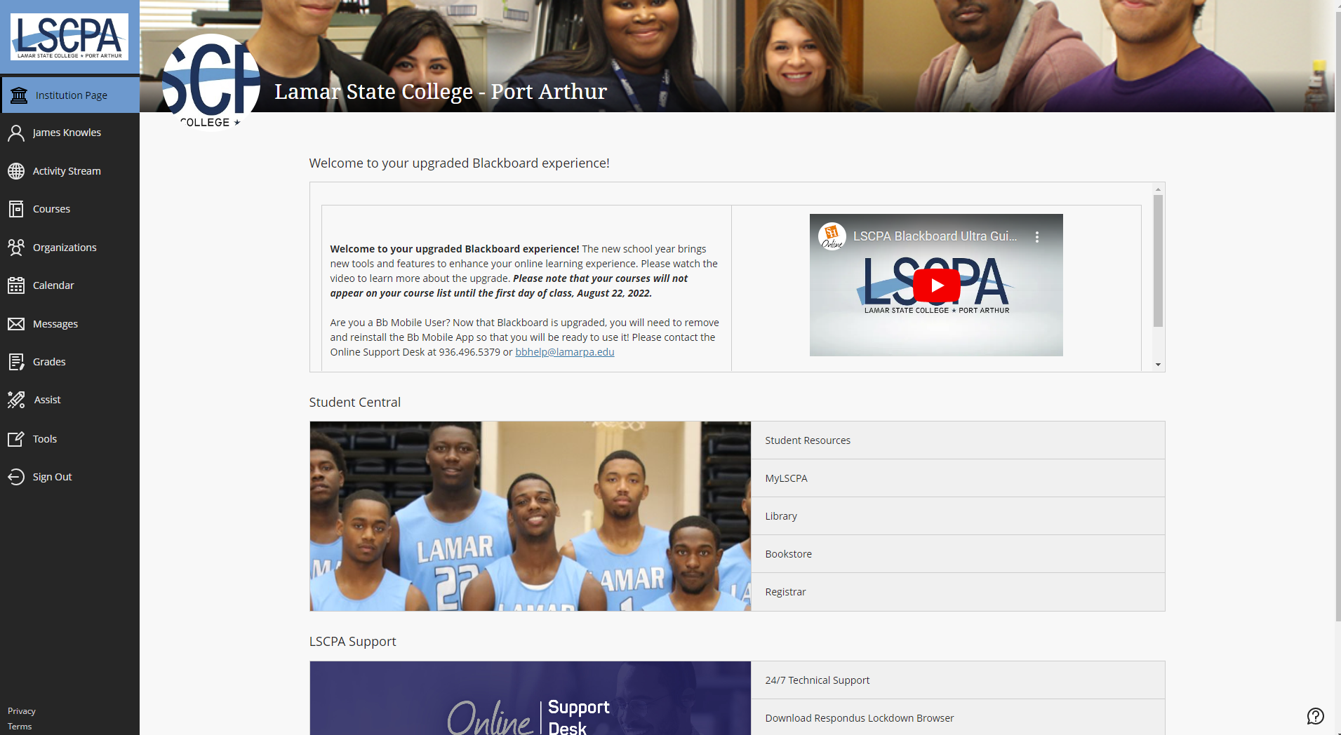
Clicking on the card brings you to the LSCPA Blackboard Institution Page, and click on Organizations

Slide 4
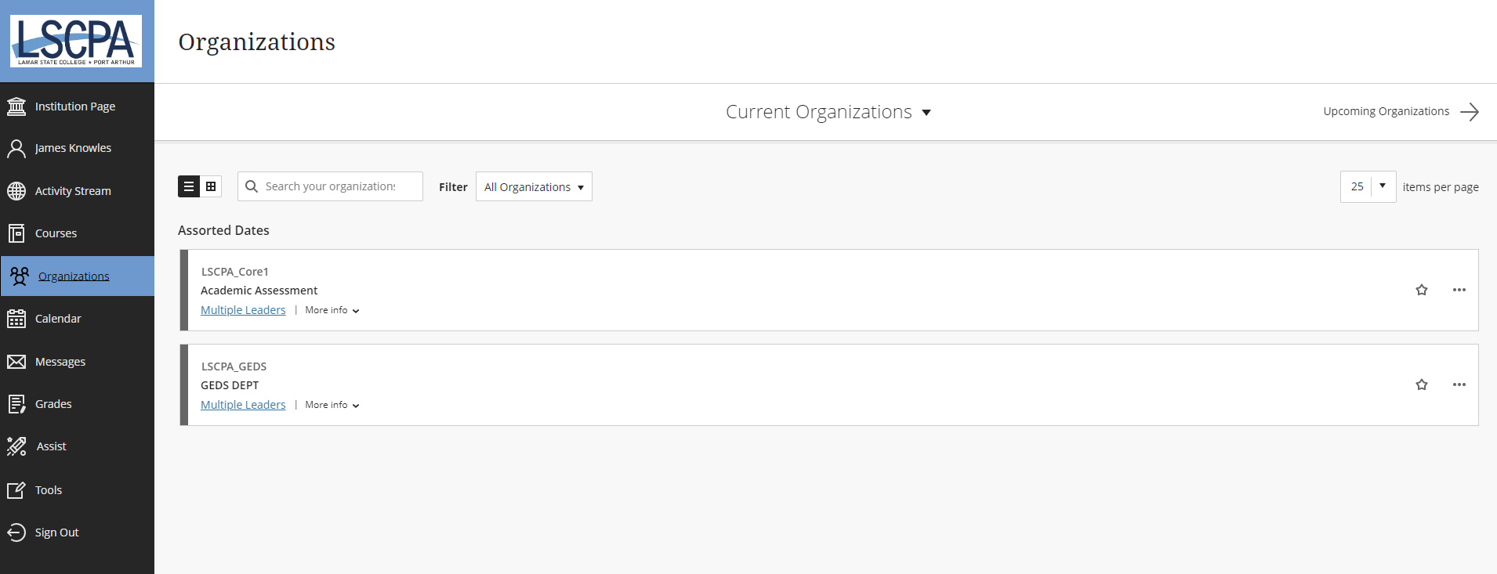
By clicking on Organizations, you will need to go to the Academic Assessment organization

Slide 5
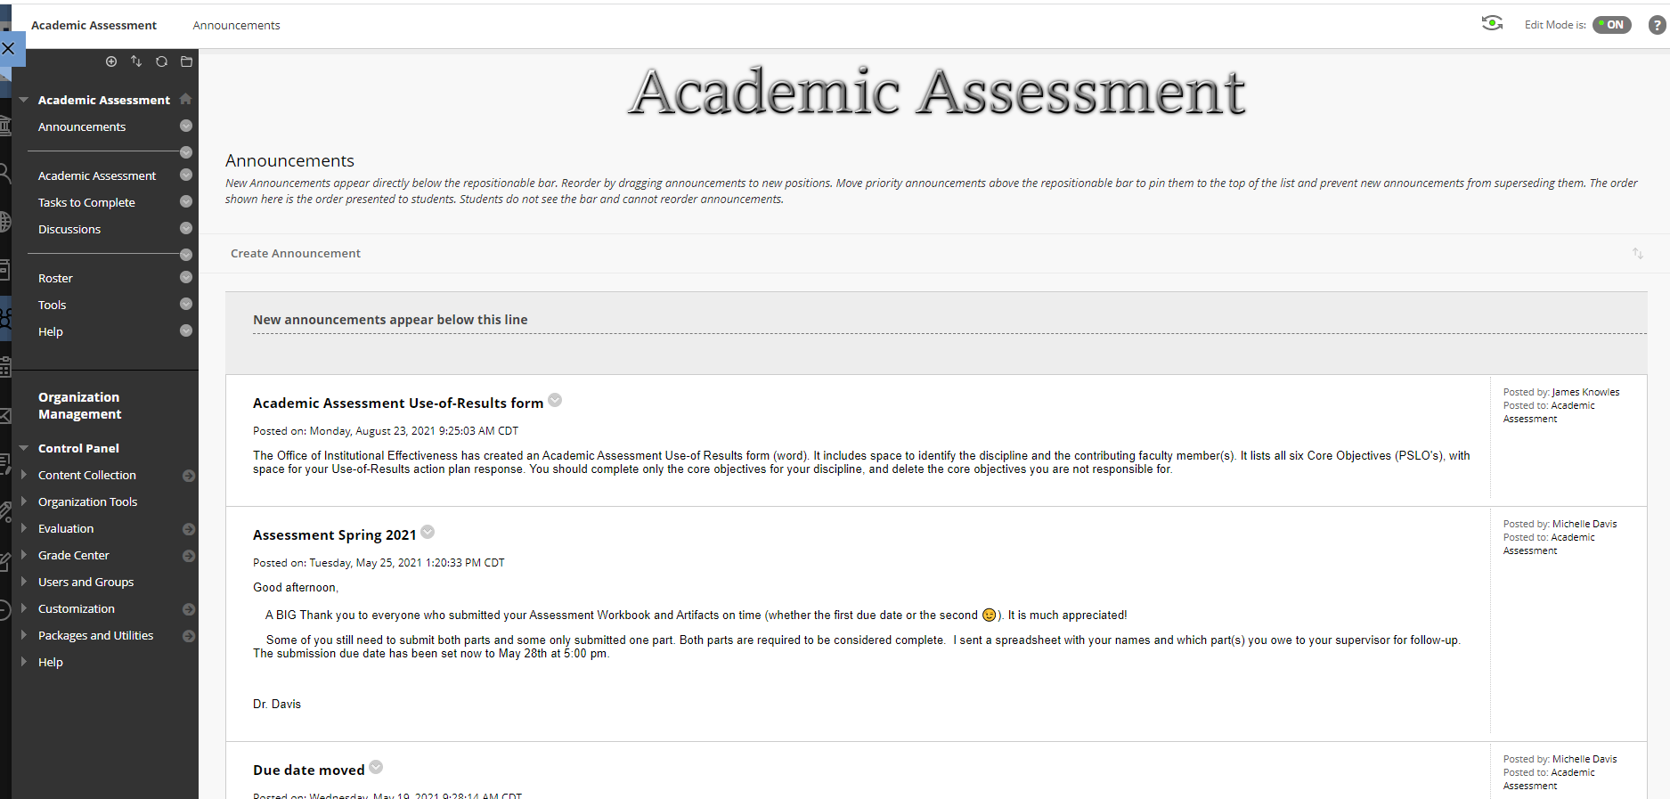
Under Academic Assessment you will find various Announcements that are posted & emailed to members

Slide 6
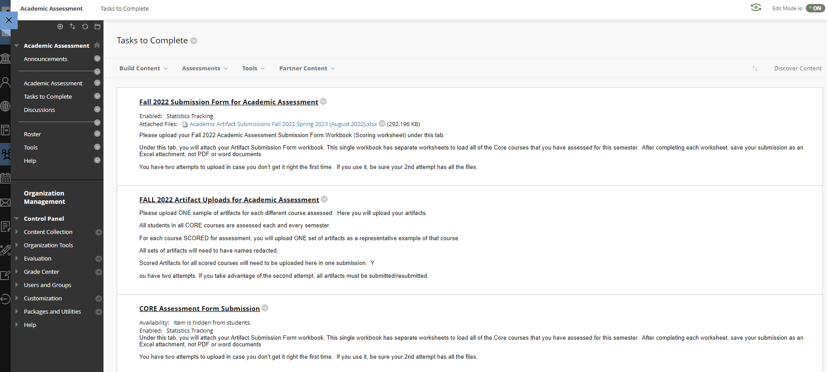
Under Academic Assessment, you will need to click on Tasks to Complete

Slide 7
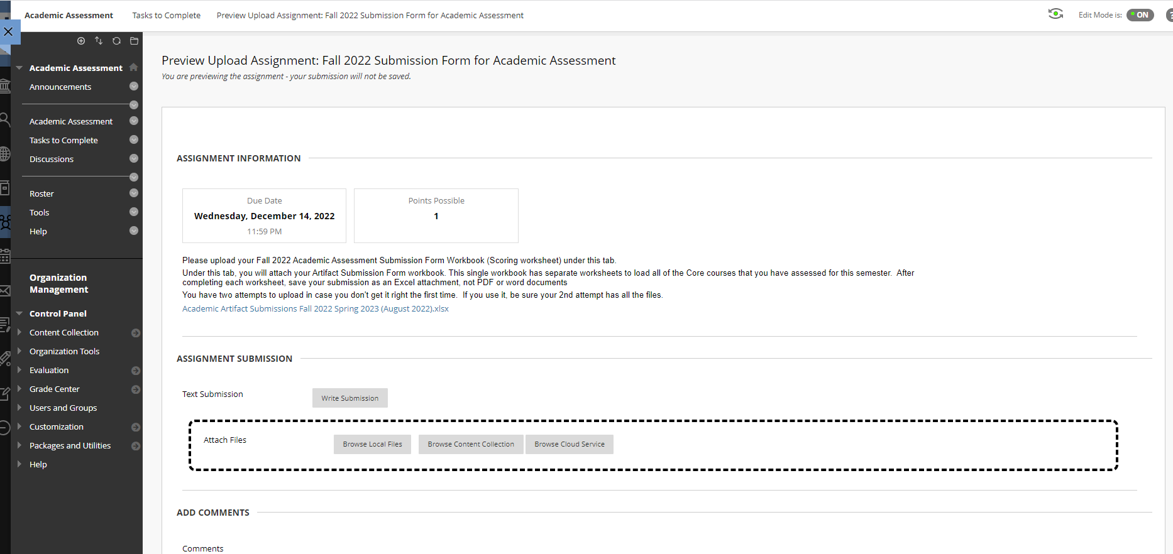
The first Task is the Submission Form and Uploads for Academic Assessment (copy of submission form and the portal to upload the submission form)

Slide 8
This is a snippet of the Submission Form for Academic Assessment (one spreadsheet within the excel workbook)

Slide 9
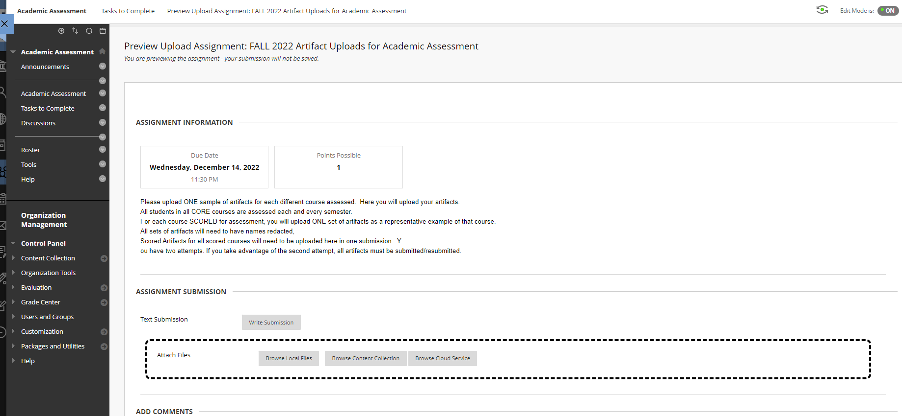
The second Task to Complete is the Artifact Uploads for Academic Assessment [copy of assignment, rating rubric, and sample(s) of artifacts]

